Slide 1
CONSTRUCTOR PATTERN

Slide 2
What Is The Design Pattern?
A design pattern is term used in software engineering for a general reusable solution to a commonly occurring problem in software design.

Slide 3
The Constructor Pattern
This is a class-based creational design pattern. Constructors are special functions that can be used to instantiate new objects with methods and properties defined by that function. Constructor pattern is one of the most commonly used patterns in JavaScript for creating new objects of a given kind.
As probably you know, JavaScript doesn't support the concept of classes but it does support special constructor functions. By simply prefixing a call to a constructor function with the keyword 'new', you can tell JavaScript you would like a function to behave like a constructor and instantiate a new object with the members defined by that function.

Slide 4
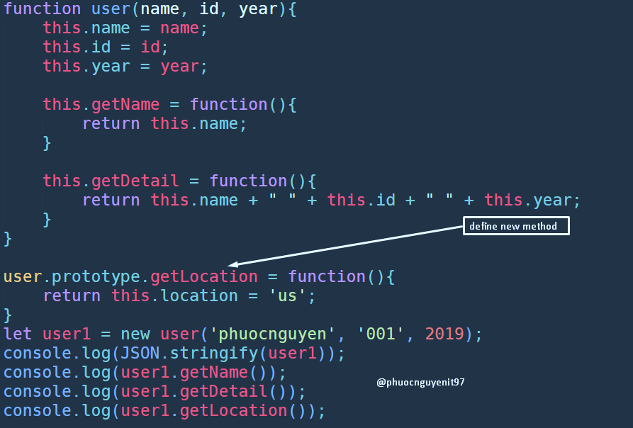
Illustration

